Slide 1
Chef for Non-Tech (Staff)
Introduction
Notes:
This Chef Essentials course provides a basic understanding of Chef's core components, basic architecture, commonly used tools, and basic troubleshooting methods.
This should provide you with enough knowledge to start using Chef to automate common infrastructure tasks and express solutions to common infrastructure problems.
Instructor Note: Be sure to read Appendix Z for training lab set up notes and additional instructor notes.

Slide 2

Notes:
Before we jump into introductions, I do want to talk about the tools we’ll be using for this class. You all have connected via Zoom Meeting. Zoom enables us to chat with the entire class or individually. But, it also has a lot of tools you may not have been aware existed.
For example, I can share a whiteboard with you all, and we can collaborate by writing on that board.
Another really cool collaboration tool is something called a Breakout Session. I can break you up into groups and you can work on labs together. I plan to do that when we jump into the actual fun of creating recipes and cookbooks in Chef.
I will be using both of these tools throughout this class (at least I hope so!)

Slide 3

Notes:
How many of you have had to answer that dreaded question: What is Chef?
How many of you have been asked if we are a culinary arts organization?
How do you explain it to your in-laws?

Slide 4

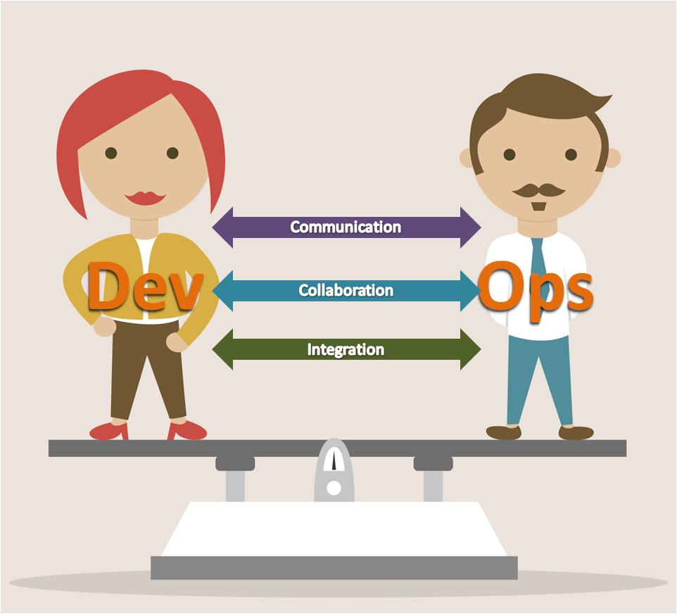
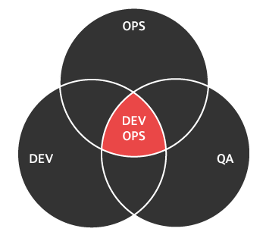

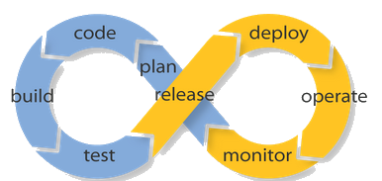
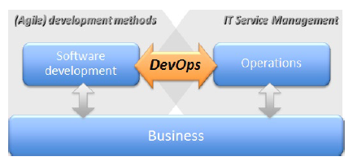
Notes:
Click At the core of what we do is something called DevOps.
DevOps is a term we hear a lot here at Chef. Everyone talks about it. Adam Jacobs gave a key note address on the topic at ChefConf a while back.
I don’t know about you all, but I turn to almighty Google when I’m not sure what something means. I actually check the Internet before I ask a live person.
And when I do, I am confronted by every infographic possible. Like this Venn diagram. [CLICK] Or this infinity thing. [CLICK TILL YOU GET TO THE OMG] And so on and so on and so on!
And in the end, I think I am more confused about DevOps than when I started.

Slide 5

Notes:
Maybe Nathen Harvey can help. Let’s see.
Okay, let’s talk about that.
OPEN WHITEBOARD AND GET OPINIONS. CMD SHIFT D

Slide 6
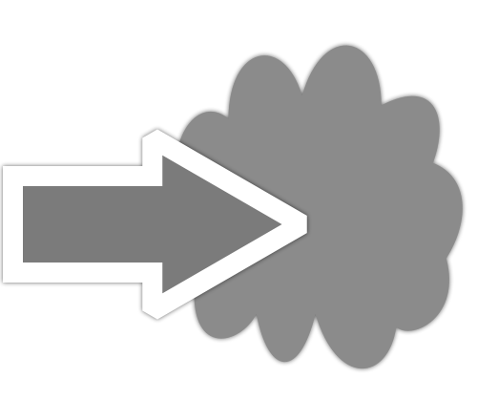




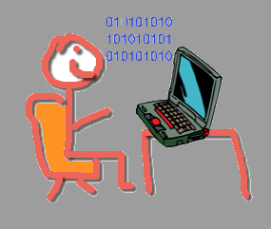
BUILD
DEPLOY
CENTRAL REPOSITORY
TEST
OPERATIONS
DEVOPS
DEVELOPERS
MONITOR AND IMPROVE
Notes:
Okay, that kind of helped. But I think that the easiest way to define or understand DevOps is to think about the parts of the word.
Dev – Development. These are your software people – the ones who actually write the code that is the basis of every application you might encounter.
What makes this position different in a DevOps culture is that instead of writing an application or program from start to finish, the developer writes it in small increments (say a feature or two) and publishes those up to a central repository from which the operations people can retrieve it.
Ops – Operations. The operations people work with the Developers to build infrastructure, test applications and deploy those up to the cloud.
Then, those apps/features/tools are used by the end users and the Developers and Operations people continue to monitor their use and look bugs or problems and they can improve very fast.
The benefits of this system are multi-fold. For example, products are deployed at an exponentially faster rate. There are fewer problems with products, because the people who build the infrastructure on which applications are used are communicating with developers on an ongoing basis, and testing or QA happens throughout the process. This saves time and money.
So, now that we [sort of] understand the wonderful idea that is DevOps, let’s talk about Chef specifically. But, we can’t really talk about Chef without understanding the words we need to use to talk about Chef.

Slide 7
Application
Notes:
Okay, so now that we understand DevOps. Let’s talk about your typical infrastructure.
Your application or website starts out with an idea. And that idea, well, it starts out small. So, you create a webpage with a single app server to share your idea with the world.
If your idea never grew, this probably would be enough.

Slide 8
Application Database
Application
Notes:
But your idea is amazing, and people start wanting to use it. So, you realize you may need to add an application database to store the data related to the activity on your webpage.

Slide 9
Application Database
Application
Application Database
Notes:
And more people visit your webpage. More traffic means you need another application database.

Slide 10
Application Database
Application
Server
Application Database
Application Server
Notes:
But now, more and more people are visiting your site and using your application – so you need to add another app server to the mix.

Slide 11
Application
Database
Application
Server
Application Database
Application Server
Load Balancer
Application
Server
Notes:
Your application is getting really popular, and more and more people are coming to your website – so much so that occasionally your website gets bogged down with all that traffic. You need a way to manage all that traffic. A load balancer should do the trick. The load balancer will balance web traffic across your app servers.

Slide 12
Application
Database
Application
Server
Load Balancer
Application Database
Application Server
Application
Server
Load Balancer
Application
Server
Notes:
And your site is getting more and more popular every day, so now you need to add another app server and another load balancer.

Slide 13
Application
Server
Application
Database
Application
Database
Cache
Load Balancer
Application Server
Application Database
Application
Database
Cache
Load Balancer
Application
Server
Load Balancer
Application
Server
Application
Server
Notes:
There is so much data out there, so might be a good idea to cache some of that data. So, you add a couple of application database cache servers.

Slide 14

Application
Database
Application
Database
Cache
Application
Server
Load Balancer
Application Server
Application Database
Application
Database
Cache
Load Balancer
Application
Server
Load Balancer
Application
Server
Application
Server
Notes:
So, you have your database servers talking to the database cache servers, and the database cache servers are talking to the app servers, and the load balancers are all managing the traffic across the app servers so that no individual server gets overloaded.

Slide 15
Application
Database
Cache
Application
Server
Application Cache
Database Slave
Load Balancer
Application
Database
Application
Database
Cache
Application Server
Application
Cache
Database Slave
Load Balancer
Application
Server
Application Database
Application
Cache
Database Slave
Load Balancer
Application
Database
Cache
Application
Server
Application
Cache
Database Slave
Application
Database
Cache
Application
Server
Notes:
And your site continues to grow and see more traffic. So, eventually, you need to add app cache servers to store any additional application data.
Phew – could you imagine if you had to do all this work yourself?

Slide 16

SPEAK
Notes:
I call this ChefSpeak.
These are the words you probably hear bandied about the office. Stuff like, resource, recipe, cookbook, Berkshelf, serverspec – fun stuff like that. Let’s talk about what those words actually mean, and how they work together.
Shift to White Board:
Do discussion about Resources, Recipes, Cookbooks, Test Kitchen, Berkshelf, Chef Server

Slide 17
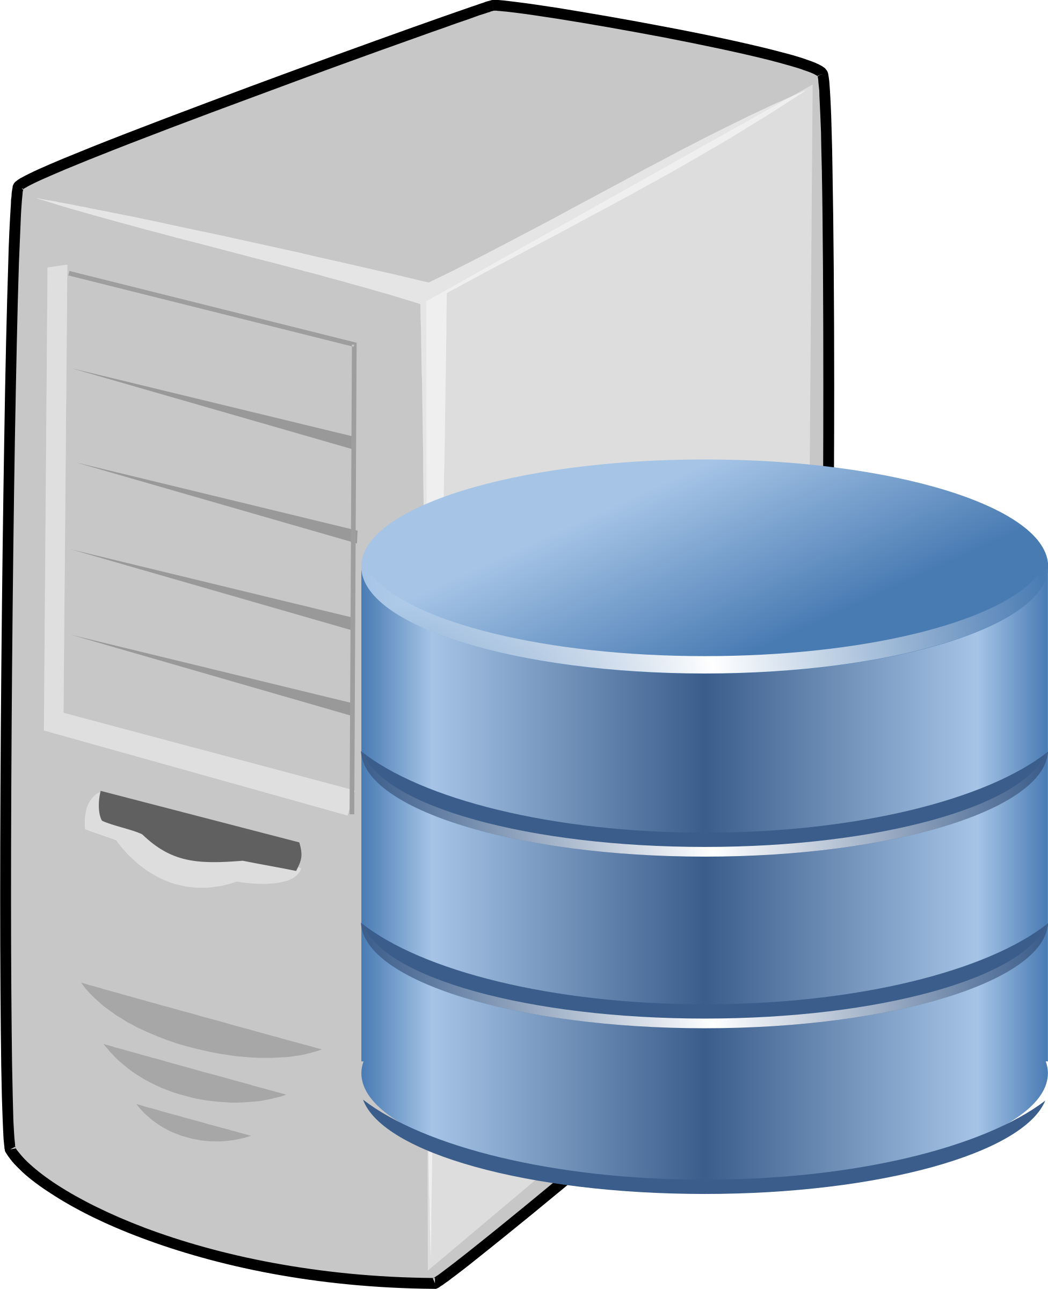
Managed Nodes
Chef Server
Recipes
Cookbooks
Resources
Notes:
Throughout this class, you will hear me mention the term resource (or resources). Resources are the basic building blocks of Chef configuration. They describe how you want your system to look. For example, if you want an application installed on all the computers on your system, then you would use a resource called package which basically starts the ball rolling to install an application package.
[CLICK] Resources are compiled into Recipes. Recipes are files written in the programming language Ruby. They always end with the file extension .rb.
[CLICK] Recipes are stored or “packaged” into Cookbooks (which are actually directories). Cookbooks describe a specific scenario. For example, if you want to set up a certain type of computer, say the load balancer we talked about earlier, then you would use a cookbook to do that. In that cookbook you would include all the recipes necessary to set up a load balancer. You would also include in that cookbook configuration files, templates, testing tools – everything you would need to set up the load balancer.
[CLICK] After you finish writing your cookbook, you upload that to the Chef Server. Usually, the Chef Server is what we call a virtualized machine (it can be a physical machine or it can be something that is hosted. Chef provides a hosting service to our clients, but they don’t necessary have to use Chef’s hosted service – they can have internal servers, they can pay for hosting from another vendor – there are a lot of possibilities).
[CLICK] Once the cookbooks have been uploaded to the Chef Server, a process called Converge happens. During this process, all the nodes that live in the cloud are brought up-to-date based upon the cookbook configuration. By default, this converge process is automated. Chef is set up so that the nodes communicate with the Chef Server every 30 minutes. However, Chef is completely customizable, so that default setting can be changed.
So, does anyone know what we call it when everything is up to date and the managed nodes have all the right cookbooks?

Slide 18
Desired state
Notes:
That’s right, we call this the desired state.

Slide 19
Managed Nodes
Chef Server
CHEF CLIENT (CONVERGE)
KNIFE
(BERKSHELF)
Recipes
Cookbooks
Resources
LOCAL WORKSTATION
Notes:
Now, back to the whole Chef Process, [CLICK] The recipes and cookbooks typically are built on your local apache.
[CLICK] You upload the cookbooks to the Chef server using a command line tool called Knife. There also is a tool called Berkshelf that is used to upload cookbooks. We’ll talk about that in more detail later in the class. Let’s just say it makes your life much much easier.
[CLICK] And as I stated earlier, the cookbooks are converged onto the nodes from the Chef Server. This is accomplished using a command line tool called Chef-Client.

Slide 20

Infrastructure as Code
Test Kitchen
Notes:
There are so many other terms we could define, but then we would be here for weeks. So, aside from what we have already talked about, there is one more term you may have heard that I want to mention, and that’s Test Kitchen. Test Kitchen really is one place where Chef shines. I fan girl over it all the time, frankly.
[CLICK] The benefit of using a configuration management tool like Chef is that infrastructure is built as code. When I first head that term, I was like “what the what?” But, 8 months later, I get it. Basically, we write Rub code into our recipes, which we compile into our cookbooks. That code describes how we want our infrastructure to look. And because it’s code, we can test it like code. That this is where test kitchen comes into play.

Slide 21


Notes:
So, if you think about it this way – our managed nodes out in the cloud are our production environment. [CLICK] This is what the rest of the world is going to see – our website/our application.
But, before we put it out there, we need to make sure that it’s going to work okay. [CLICK] We need to have a test environment. This is what test kitchen does for us. It creates the test environment that looks exactly like our production environment. Then it tests all the code in our recipes and cookbooks to make sure they do exactly what we expect them to do.
Then, we we are ready to deploy, we don’t have to worry that something will break.

Slide 22
Notes:
Okay, now we are going to move onto playing with some of the chef tools. Before we do that, let’s go ahead and take break. Process all that covered and when we come back we’ll have a brief Q/A period and then jump into playing with Resources, recipes and cookbooks!

Slide 23
Hosted Chef and Chef Server

Slide 24
https://manage.chef.io/signup
Notes:
So, before we go any further, we need to set ourselves up with a hosted chef account. Some of you may have done this in the past – but we’ll figure that out when we get there. So, every go to this website (I will paste it into the chat for you)
[WALK THROUGH THE STEPS OF SETTING UP HOSTED CHEF]
[Depending on how long this takes, we may break afterwards]

Slide 25
knife
knife is a command-line tool that provides an interface between a local chef-repo and the Chef Server.
Notes:
knife is a command-line tool that allows us to request and send information to the Chef Server.
knife helps users mananodes; cookbooks; roles; environments; and more. knife does this through a series of sub-commands.

Slide 26
knife --help
$ knife --help
Available subcommands: (for details, knife SUB-COMMAND --help)
** BOOTSTRAP COMMANDS **
knife bootstrap FQDN (options)
knife bootstrap windows ssh FQDN (options)
knife bootstrap windows winrm FQDN (options)
** CLIENT COMMANDS **
knife client bulk delete REGEX (options)
knife client create CLIENT (options)
knife client delete CLIENT (options)
knife client edit CLIENT (options)
Notes:
You can look at all the commands with 'knife –help'.
This will display all the sub-commands available. In your case you want to verify that the client list contains a single entry so you need to look for help for the specific command 'knife client --help'.

Slide 27
knife client --help
$ knife client --help
Available client subcommands: (for details, knife SUB-COMMAND --help)
** CLIENT COMMANDS **
knife client bulk delete REGEX (options)
knife client create CLIENT (options)
knife client delete CLIENT (options)
knife client edit CLIENT (options)
knife client list (options)
knife client reregister CLIENT (options)
knife client show CLIENT (options)
Notes:
This will give us an even smaller subset of the commands related specifically to asking the Chef Server about client information. A general command is the list command which will output all the clients that the Chef Server currently maintains.

Slide 28
knife client list
$ knife client list
ORGNAME-validator
Notes:
For your Chef Server account there should be a single client that is the organization name: validator. This is a special key that has access to the Chef Server. The important thing is that the result does not contain an error with the configuration or authenticating with the Chef Server.
If you receive an error ensure that you: typed the command correctly; executed the command within the chef repository directory; are connected to the internet and not blocking ssl connections from your own system's proxy servers or virtual private networks; and have a .chef directory, within the chef repository, which contains the knife configuration file (knife.rb), personal key, and organizational key.

Slide 30
Resources, Recipes, & Cookbooks
Notes:
Okay, so now that we have our hosted Chef account and with that an actual chef server, we need to start building our infrastructure. The first thing we want to do is open up a command line tool – like iterm. Does everyone know what I mean by this?

Slide 31
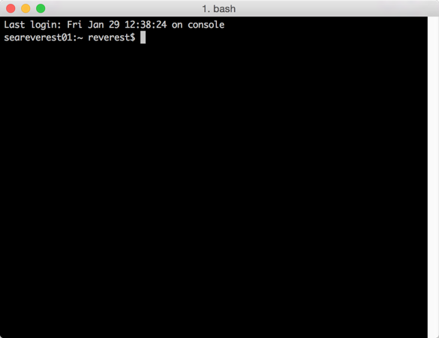
Notes:
For example, I work in a bash shell. I imagine many of you know where this is. If not, just let me know.

Slide 32
Change into the Cookbooks Directory
$ cd chef-repo
$ cd cookbooks
Notes:
So we’re using Linux here, and in Linux we are going to create some directories and just get some housekeeping done.
For this class, create a directory entitled chef-repo. you’ll use the command mkdir to make the directory. You will be working in this directory from here forward.
After you create the directory, you’ll need to move into that directory. We do this with the command cd (change directory) and the name of the directory.
Now, let’s make a subdirectory in chef-repo called cookbooks. Chef requires that all cookbooks be kept in a cookbooks directory. Let’s go ahead and cd into the cookbooks directory.
Now, we are ready to start cooking!

Slide 33
Create a Web Server Cookbook
Group Lab
Use chef to generate a cookbook to store our recipes.
Create a recipe to manage a Web Server.
Notes:
Now that we have place for our cookbooks to live, let’s go ahead and create a cookbook we can use to manage a web server.

Slide 34
What is 'chef'?
An executable program that allows you generate cookbooks and cookbook components.
Notes:
To do this, we are going to use an executable program called chef. This is a “lower case” chef – which is different from our company/product.
So, in our term window, we can use chef on the command line to do number of things.

Slide 35
What can 'chef' do?
$ chef --help
Usa
chef -h/--help
chef -v/--version
chef command [arguments...] [options...]
Available Commands:
exec Runs the command in context of the embedded ruby
gem Runs the `gem` command in context of the embedded ruby
generate Generate a new app, cookbook, or component
shell-init Initialize your shell to use ChefDK as your primary ruby
install Install cookbooks from a Policyfile and generate a locked cookboo...
update Updates a Policyfile.lock.json with latest run_list and cookbooks
Notes:
One thing that’s really cool about Chef is that help is always available to our users. For example, on this screen you see that we’ve entered chef –help. What I typically tell my students is that these commands are like building blocks. When we use the –help, it provides us with a list of subcommands that can be appended onto the first command we enter to perform specific functions.
For example, if we look at the results here, we see that if we append generate to the chef command, we can generate a number of things.

Slide 36
What Can 'chef generate' Do?
$ chef generate --help
Usachef generate GENERATOR [options]
Available generators:
app Generate an application repo
cookbook Generate a single cookbook
recipe Generate a new recipe
attribute Generate an attributes file
template Generate a file template
file Generate a cookbook file
lwrp Generate a lightweight resource/provider
repo Generate a Chef policy repository
policyfile Generate a Policyfile for use with the install/push commands
Notes:
Let's examine the 'chef generate' command. We can see that the command is capable of generating a large number of different things for us. It looks like if we want to generate a cookbook we're going to need to use 'chef generate cookbook'.

Slide 37
What Can 'chef generate cookbook' Do?
$ chef generate cookbook --help
Usachef generate cookbook NAME [options]
-C, --copyright COPYRIGHT Name of the copyright holder - default...
-m, --email EMAIL Email address of the author - defaults...
-a, --generator-arg KEY=VALUE Use to set arbitrary attribute KEY to ...
-I, --license LICENSE all_rights, httpd, mit, gplv2, gplv3 -...
-g GENERATOR_COOKBOOK_PATH, Use GENERATOR_COOKBOOK_PATH for the...
--generator-cookbook
Notes:
Let's ask the 'chef generate cookbook' command for help to see how it is used.
To generate a cookbook, all we have to do is provide it with a name.
There are two hard things in Computer Science and one of those is giving something a name.

Slide 38
Let's Create a Cookbook
$ chef generate cookbook apache
Compiling Cookbooks...
Recipe: code_generator::cookbook
* directory[/home/chef/apache] action create
- create new directory /home/chef
* template[/home/chef/apache/metadata.rb] action create_if_missing
- create new file /home/chef/apache/metadata.rb
- update content in file /home/chef/apache/metadata.rb from none to bd85d3
(diff output suppressed by config)
* template[/home/chef/apache/README.md] action create_if_missing
- create new file /home/chef/apache/README.md
- update content in file /home/chef/apache/README.md from none to 44d165
(diff output suppressed by config)
* cookbook_file[/home/chef/apache/chefignore] action create
Notes:
We have you covered. Call the cookbook apache. That's a generic enough name.
We want you to use 'chef generate' to generate a cookbook named apache.

Slide 39
The Cookbook Has a README
$ tree apache
apache
├── Berksfile
├── chefignore
├── metadata.rb
├── README.md
├── recipes
│ └── default.rb
├── spec
│ ├── spec_helper.rb
│ └── unit
│ └── recipes
│ └── default_spec.rb
10 directories, 9 files
Notes:
INSTRUCTOR NOTE: Because we haven’t done some of the first day exercises, our students will not have the tree command. Do the tree stuff as a demo and explain to them what you are doing.
Aren't you curious what's inside it?
Let's take a look with the help of the 'tree' command. If we provide 'tree' with a path we will see all the visible files in the specified directory. [note they haven’t installed this yet]
So the chef cookbook generator created an outline of a cookbook with a number of default files and folders. The first one we'll focus on is the README.

Slide 40
README.md
The description of the cookbook's features written in Markdown.
http://daringfireball.net/projects/markdown/syntax
Notes:
All cookbooks that 'chef' will generate for you will include a default README file. The extension .md means that the file is a markdown file.
Markdown files are text documents that use various punctuation characters to provide formatting. They are meant to be easily readable by humans and can be easily be rendered as HTML or other formats by computers.

Slide 41
The Cookbook Has Some Metadata
$ tree apache
apache
├── Berksfile
├── chefignore
├── metadata.rb
├── README.md
├── recipes
│ └── default.rb
├── spec
│ ├── spec_helper.rb
│ └── unit
│ └── recipes
│ └── default_spec.rb
10 directories, 9 files
Notes:
The cookbook also has a metadata file.

Slide 42
metadata.rb
Every cookbook requires a small amount of metadata. Metadata is stored in a file called metadata.rb that lives at the top of each cookbook’s directory.
http://docs.chef.io/config_rb_metadata.html
Notes:
This is a ruby file that contains its own domain specific language (DSL) for describing the details about the cookbook.

Slide 43
Let's Take a Look at the Metadata
$ cat apache/metadata.rb
name 'apache'
maintainer 'The Authors'
maintainer_email 'you@example.com'
license 'all_rights'
description 'Installs/Configures web server'
long_description 'Installs/Configures web server'
version '0.1.0'
Notes:
you can use the cat command to view the contents of your cookbooks. cat is short for concatenate. If you view the contents of your new cookbook's metadata, you'll see a number of details that help describe the cookbook:
The name of the cookbook, its maintainer, a way to reach them, how the cookbook is licensed, descriptions, and the cookbook's version number.

Slide 44
The Cookbook Has a Folder for Recipes
$ tree apache
apache
├── Berksfile
├── chefignore
├── metadata.rb
├── README.md
├── recipes
│ └── default.rb
├── spec
│ ├── spec_helper.rb
│ └── unit
│ └── recipes
│ └── default_spec.rb
10 directories, 9 files
Notes:
The cookbook also has a folder named recipes. This is where we store the recipes in our cookbook. You'll see that the generator created a default recipe in our cookbook. What does it do?

Slide 45
The Cookbook Has a Default Recipe
$ cat apache/recipes/default.rb
# Cookbook Name:: apache
# Recipe:: default
#
# Copyright (c) 2015 The Authors, All Rights Reserved.
Notes:
Looking at the contents of the default recipe you'll find it's empty except for some ruby comments.
A cookbook doesn't have to have a default recipe but most every cookbook has one. It's called default because when you think of a cookbook, it is probably the recipe that defines the most common configuration policy.

Slide 46
Generate the apache server recipe
$ chef generate recipe apache server
Compiling Cookbooks...
Recipe: code_generator::recipe
* directory[./apache/spec/unit/recipes] action create (up to date)
* cookbook_file[./apache/spec/spec_helper.rb] action create_if_missing (up to date)
* template[./apache/spec/unit/recipes/server_spec.rb] action create_if_missing
- create new file ./apache/spec/unit/recipes/server_spec.rb
- update content in file ./apache/spec/unit/recipes/server_spec.rb from none to 15a8e6
(diff output suppressed by config)
* template[./apache/recipes/server.rb] action create
- create new file ./apache/recipes/server.rb
- update content in file ./apache/recipes/server.rb from none to 6b8381
(diff output suppressed by config)
Notes:
Okay, for this next step, you are going to want to be at the root of the apache cookbook.
Chef generate can also generate our recipe file as well. Running the command `chef generate recipe apache server` it will generate the server recipe within the apache cookbook we created.

Slide 47
The Cookbook Has a Default Recipe
$ cat apache/recipes/server.rb
# Cookbook Name:: apache
# Recipe:: server
#
# Copyright (c) 2015 The Authors, All Rights Reserved.
Notes:
If we cat that server.rb, we find that this recipe is also empty. We will need to add some resources to this recipe in order for this recipe to set up a web server.

Slide 48
The server.rb recipe file
~/apache/recipes/server.rb
package 'httpd'
file '/var/www/html/index.html' do
content '<h1>Hello, world!</h1>'
end
service 'httpd' do
action [ :enable, :start ]
end
Notes:
Here is a server.rb file with the resources added. Let’s talk about this for a second.
(desk scribble here)
The first resource we have used here is the package resource. (underline package). We are specifying that we want the package “httpd” installed.
The second resource we use is the file resource – here we are specifying that we want to create file at a specific location with specific content.
The last resource we are using is the service resource – we want the service ‘httpd” to be enabled and started.

Slide 49
Resources
A resource is a statement of configuration policy.
It describes the desired state of an element of your infrastructure and the steps needed to bring that item to the desired state.
https://docs.chef.io/resources.html
Notes:
First, let's look at Chef's documentation about resources. Visit the docs page on resources and read the first three paragraphs.
Afterwards, let us look at a few examples of resources.
Instructor Note: This may sound unusual to ask people to read the documentation site but it is important that they learn to refer to the documentation. This page in an important reference page.

Slide 50
Example: Package
package 'httpd'
The package named 'httpd' is installed.
https://docs.chef.io/resource_package.html
Notes:
Here is an example of the package resource. The package named 'httpd' is installed.
Instructor Note: The default action for the package resource is create. When you do not specify an action or attributes you can define it without the do and end block.

Slide 51
Example: Service
service 'ntp' do
action [ :enable, :start ]
end
The service named 'ntp' is enabled (start on reboot) and started.
https://docs.chef.io/resource_service.html
Notes:
In this example, the service named 'ntp' is enabled and started.
Instructor Note: Service resources are often defined with two actions. The action method can only take one parameter so to provide two actions you need to specify the two actions within an Array.

Slide 52
Example: File
file '/etc/motd' do
content 'This computer is the property ...'
end
The file name '/etc/motd' is created with content 'This company is the property ...'
https://docs.chef.io/resource_file.html
Notes:
In this example, the file named '/etc/motd' is created with content 'This company is the property...'.
Instructor Note: The default action for the file resource is to create the file.

Slide 53
Example: File
file '/etc/php.ini.default' do
action :delete
end
The file name '/etc/php.ini.default' is deleted.
https://docs.chef.io/resource_file.html
Notes:
In this example, the file named '/etc/php.ini.default' is deleted.
Instructor Note: A resource's default action is based on the principle of least surprise. So they are often creative actions towards the system. This is why the file resource specified here has the action specified. It is not the default action.

Slide 54
Resource Definition
file ’index.html' do
content 'Hello, world!'
end
The TYPE named NAME should be ACTION'd with ATTRIBUTES
Notes:
Before we actually create this recipe, let's take a moment and talk about the structure of a resource definition. We'll break down the resource that we defined in our recipe file.

Slide 55
Resource Definition
file ’index.html' do
content 'Hello, world!'
end
The TYPE named NAME should be ACTION'd with ATTRIBUTES
Notes:
The first element of the resource definition is the resource type. In this instance the type is 'file'. Earlier we used 'package'. We showed you an example of 'service'.

Slide 56
Resource Definition
file ’index.html' do
content 'Hello, world!'
end
The TYPE named NAME should be ACTION'd with ATTRIBUTES
Notes:
The second element is the name of the resource. This is also the first parameter being passed to the resource.
In this instance the resource name is also the relative file path to the file we want created. We could have specified a fully-qualified file path to ensure the file was written to the exact same location and not dependent on our current working directory.

Slide 57
Resource Definition
file ’index.html' do
content 'Hello, world!'
end
The TYPE named NAME should be ACTION'd with ATTRIBUTES
Notes:
The `do` and `end` keywords here define the beginning of a ruby block. The ruby block and all the contents of it are the second attributes to our resource.
The contents of this block contains attributes (and other things) that help describe the state of the resource. In this instance, the content attribute here specifies the contents of the file.
Attributes are laid out with the name of the attributes followed by a space and then the value for the attribute.

Slide 58
Resource Definition
file ’index.html' do
content 'Hello, world!'
end
?
The TYPE named NAME should be ACTION'd with ATTRIBUTES
Notes:
The interesting part is that there is no action defined. And if you think back to the previous examples that we showed you, not all of the resources have defined actions.
So what action is the resource taking? How do you know?

Slide 59
Edit the server.rb recipe file
$ nano apache/recipes/server.rb
Notes:
Okay, so let’s get these resources into the server recipe

Slide 60
Edit the server.rb recipe file
~/apache/recipes/server.rb
package 'httpd'
file '/var/www/html/index.html' do
content '<h1>Hello, world!</h1>'
end
service 'httpd' do
action [ :enable, :start ]
end
Notes:
So, go ahead and enter this code into the recipe, and save it when you’re done.

Slide 61
Notes:
Okay, now we are going to move onto playing with some of the chef tools. Before we do that, let’s go ahead and take break. Process all that covered and when we come back we’ll have a brief Q/A period and then jump into playing with Resources, recipes and cookbooks!

Slide 62
A Test Kitchen Demo
Notes:
Because this is a Chef for Non-Tech class, I’m not going to make y’all do a Test Kitchen lab. Instead, I will demo how it works.
Basically, before you push your cookbook up to the Chef Server, you will want to test it to make sure it works properly. Test kitchen enables you to do that very easily.
[White Board work on this]

Slide 63
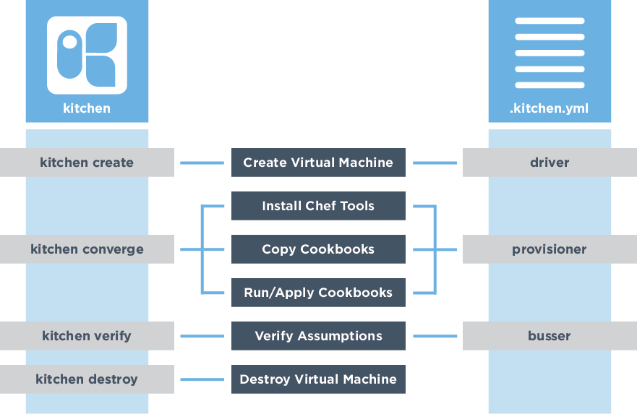
Test Kitchen Commands and Configuration
Notes:
Test Kitchen allows us to create an instance solely for testing, installs Chef, converge a run list of recipes on that instance, verify that the instance is in the desired state, and then destroy the instance.
On the left are the commands by the kitchen command that map to the stages of the testing lifecycle.
On the right are the configuration fields within a kitchen configuration file.
These commands the configuration will be explained in more detail.
Instructor Note: If you created a custom list of steps with your learners use that custom list and overlay the following information over top of it.

Slide 64
.kitchen.yml
When chef generates a cookbook, a default .kitchen.yml is created. It contains kitchen configuration for the driver, provisioner, platform, and suites.
http://kitchen.ci/docs/getting-started/creating-cookbook
Notes:
We don't need to run `kitchen init` because we already have a default kitchen file. We may still need to update it to accomplish our objectives so lets learn more about the various fields in the configuration file.

Slide 65
The kitchen Driver
~/cookbooks/apache/.kitchen.yml
---
driver:
name: vagrant
provisioner:
name: chef_zero
platforms:
- name: ubuntu-12.04
- name: centos-6.5
...
The driver is responsible for creating a machine that we'll use to test our cookbook.
Example Drivers:
docker
vagrant
Notes:
The first key is driver, which has a single key-value pair that specifies the name of the driver Kitchen will use when executed.
The driver is responsible for creating the instance that we will use to test our cookbook. There are lots of different drivers available--two very popular ones are the docker and vagrant driver.
Instructor Note: Testing on this remote apache requires that we use Docker because Vagrant does not work within a virtual environment. Vagrant is the standard choice when working on your local apache.

Slide 66
The kitchen Provisioner
~/cookbooks/apache/.kitchen.yml
---
driver:
name: vagrant
provisioner:
name: chef_zero
platforms:
- name: ubuntu-12.04
- name: centos-6.5
...
This tells Test Kitchen how to run Chef, to apply the code in our cookbook to the machine under test.
The default and simplest approach is to use chef_zero.
Notes:
The second key is provisioner, which also has a single key-value pair which is the name of the provisioner Kitchen will use when executed. This provisioner is responsible for how it applies code to the instance that the driver created. Here the default value is chef_zero.

Slide 67
The kitchen Platforms
~/cookbooks/apache/.kitchen.yml
---
driver:
name: vagrant
provisioner:
name: chef_zero
platforms:
- name: ubuntu-12.04
- name: centos-6.5
...
This is a list of operation systems on which we want to run our code.
Notes:
The third key is platforms, which contains a list of all the platforms that Kitchen will test against when executed. This should be a list of all the platforms that you want your cookbook to support.

Slide 68
The kitchen Suites
~/cookbooks/apache/.kitchen.yml
...
suites:
- name: default
run_list:
- recipe[apache::default]
attributes:
This section defines what we want to test. It includes the Chef run-list of recipes that we want to test.
We define a single suite named "default".
Notes:
The fourth key is suites, which contains a list of all the test suites that Kitchen will test against when executed. Each suite usually defines a unique combination of run lists that exercise all the recipes within a cookbook.
In this example, this suite is named 'default'.

Slide 69
The kitchen Suites
~/cookbooks/apache/.kitchen.yml
...
suites:
- name: default
run_list:
- recipe[apache::default]
attributes:
The suite named "default" defines a run_list.
Run the "apache" cookbook's "default" recipe file.
Notes:
This default suite will execute the run list containing: The apache cookbook's default recipe.

Slide 70
Kitchen Test Matrix
Kitchen defines a list of instances, or test matrix, based on the platforms multiplied by the suites.
PLATFORMS x SUITES
Running kitchen list will show that matrix.
Notes:
It is important to recognize that within the .kitchen.yml file we defined two fields that create a test matrix; The number of platforms we want to support multiplied by the number of test suites that we defined.

Slide 71
Kitchen Create
kitchen create
kitchen converge
kitchen verify
$ kitchen create [INSTANCE|REGEXP|all]
Create one or more instances.
Notes:
The first kitchen command is `kitchen create`.
To create an instance means to turn on virtual or cloud instances for the platforms specified in the kitchen configuration.
In our case, this command would use the Docker driver to create a docker image based on centos-6.7.
Instructor Note: The command does allow you to create specific instances by name or all instances that match a provided criteria.

Slide 72
Kitchen Converge
kitchen create
kitchen converge
kitchen verify
$ kitchen converge [INSTANCE|REGEXP|all]
Create the instance (if necessary) and then apply
the run list to one or more instances.
Notes:
Creating an image gives us a instance to test our cookbooks but it still would leave us with the work of installing chef and applying the cookbook defined in our .kitchen.yml run list.
So let's introduce you to the second kitchen command: `kitchen converge`.
Converging an instance will create the instance if it has not already been created. Then it will install chef and apply that cookbook to that instance.
In our case, this command would take our image and install chef and apply the apache cookbook's default recipe.
Instructor Note: It also, like the `kitchen create` commands, defaults to all instances when executed without any parameters. And is capable of accepting parameters to converge a specific instance or all instances that match the provided criteria.

Slide 73
Kitchen Verify
kitchen create
kitchen converge
kitchen verify
$ kitchen verify [INSTANCE|REGEXP|all]
Create, converge, and verify one or more
instances.
Notes:
The third kitchen command is `kitchen verify`.
To verify an instance means to:
Create a virtual or cloud instances, if needed
Converge the instance, if needed
And then execute a collection of defined tests against the instance
In our case, our instance has already been created and converged so when we run `kitchen verify` it will execute the tests that we will later define.
Instructor Note: It works as the other commands do with regard to parameters and targeting instances.

Slide 74
Kitchen Destroy
kitchen create
kitchen converge
kitchen verify
kitchen destroy
$ kitchen destroy [INSTANCE|REGEXP|all]
Destroys one or more instances.
Notes:
The fourth kitchen command is `kitchen destroy`.
Destroy is available at all stages and essentially cleans up the instance.
Instructor Note: It works as all the other commands do with regard to parameters and targeting instances.

Slide 75
Kitchen Test
kitchen destroy
kitchen converge
kitchen verify
kitchen destroy
kitchen create
$ kitchen test [INSTANCE|REGEXP|all]
Destroys (for clean-up), creates, converges, verifies
and then destroys one or more instances.
Notes:
There a single command that encapsulates the entire workflow - that is `kitchen test`.
Kitchen test ensures that if the instance was in any state - created, converged, or verified - that it is immediately destroyed. This ensures a clean instance to perform all of the steps: create; converge; and verify. `kitchen test` completes the entire execution by destroying the instance at the end.
Traditionally this all encompassing workflow is useful to ensure that we have a clean state when we start and we do not leave a mess behind us.

Slide 77
Knife and Berkshelf
Notes:
So, now that we have generated our cookbook, used resources to build a recipe and tested our code (or at least talked about that piece) – we can push everything up to the Chef Server.

Slide 78
knife cookbook --help
$ knife cookbook --help
** COOKBOOK COMMANDS **
knife cookbook bulk delete REGEX (options)
knife cookbook create COOKBOOK (options)
knife cookbook delete COOKBOOK VERSION (options)
knife cookbook download COOKBOOK [VERSION] (options)
knife cookbook list (options)
knife cookbook metadata COOKBOOK (options)
knife cookbook metadata from FILE (options)
knife cookbook show COOKBOOK [VERSION] [PART] [FILENAME] (options)
knife cookbook test [COOKBOOKS...] (options)
knife cookbook upload [COOKBOOKS...] (options)
Notes:
Similar to asking the Chef Server about the list of available clients, you can also ask for information about cookbooks. You can find all the commands related to the cookbooks subcommand by running `knife cookbook --help`.
Similar to the list of clients, you can examine a list of cookbooks.

Slide 79
knife cookbook list
$ knife cookbook list
Notes:
Running this command will return the cookbooks currently uploaded to the Chef Server. The empty response should come as no surprise.
You want to change that. So you are going to upload each of your cookbooks to the Chef Server.

Slide 80
Change to the cookbooks/apache Directory
$ cd cookbooks/apache
Notes:
To upload a cookbook to the Chef Server you need to be within the directory of the cookbook. Let us start with the apache cookbook. Change directory into the apache cookbook directory which is within the cookbooks directory.

Slide 81

And no, we aren’t talking about a crazy meme we all pass around on Slack!
Notes:
So this brings us to Berkshelf.
And no, it’s not just some crazy meme you pass around on slack (or are Steve DelFante and me the only ones who do that?)

Slide 82
Berkshelf
Berkshelf is a cookbook management tool that allows us to upload your cookbooks and all of its dependencies to the Chef Server.
berkshelf.com
Notes:
Berkshelf is a cookbook management tool that allows us to upload your cookbooks and all of its dependencies to the Chef Server. In this instance, your current cookbooks have no dependencies, but in the future when they do, Berkshelf will assist you in ensuring those are all uploaded.
[JUMP TO WHITE BOARD TO ILLUSTRATE THIS]

Slide 83
Run berks --help
$ berks --help
Commands:
berks apply ENVIRONMENT # Apply version locks from Berksfile.lock to a Chef environment
berks contingent COOKBOOK # List all cookbooks that depend on the given cookbook in your
berks cookbook NAME [PATH] # Create a skeleton for a new cookbook
berks help [COMMAND] # Describe available commands or one specific command
berks info [COOKBOOK] # Display name, author, copyright, and dependency information
berks init [PATH] # Initialize Berkshelf in the given directory
berks install # Install the cookbooks specified in the Berksfile
berks list # List cookbooks and their dependencies specified by your
berks outdated [COOKBOOKS] # List dependencies that have new versions available that
berks package [PATH] # Vendor and archive the dependencies of a Berksfile
berks search NAME # Search the remote source for cookbooks matching the partial
Notes:
Berkshelf is a command-line tool that you can ask to see available the commands.

Slide 84
Run berks install
$ berks install
Resolving cookbook dependencies...
Fetching 'apache' from source at .
Fetching cookbook index from https://supermarket.chef.io...
Using apache (0.2.1) from source at .
Notes:
Berkshelf is used on a per-cookbook basis. As dependencies are often per cookbook you'll need to change into the directory of the cookbook.
You should install any dependencies that your cookbook might have. Again, in this instance there are no dependencies external to this cookbook but Berkshelf ensures that this is the case when it runs the 'berks install' command.
You'll see that it finds the current cookbook within your current directory, it contacts the Supermarket for any external dependencies, and then ...

Slide 85
See the Berksfile.lock
$ ls -al (or ls -Force if using Powershell)
drwxr-xr-x 7 chef chef 4096 Aug 27 18:44 .
drwxr-xr-x 4 chef chef 4096 Aug 27 16:17 ..
drwxr-xr-x 8 chef chef 4096 Aug 27 16:07 .git
-rw-r--r-- 1 chef chef 126 Aug 27 15:46 .gitignore
drwxr-xr-x 3 chef chef 4096 Aug 27 18:45 .kitchen
-rw-r--r-- 1 chef chef 183 Aug 27 18:44 .kitchen.yml
-rw-r--r-- 1 chef chef 47 Aug 27 15:46 Berksfile
-rw------- 1 chef chef 77 Aug 27 18:45 Berksfile.lock
-rw-r--r-- 1 chef chef 54 Aug 27 15:46 README.md
-rw-r--r-- 1 chef chef 974 Aug 27 15:46 chefignore
-rw-r--r-- 1 chef chef 198 Aug 27 15:46 metadata.rb
drwxr-xr-x 2 chef chef 4096 Aug 27 16:34 recipes
Notes:
...it completes by writing a Berksfile.lock to the file system.
The Berksfile.lock is a receipt of all the cookbooks and dependencies found at the exact moment that you ran 'berks install'.

Slide 86
See the Contents of the Berksfile.lock
$ cat Berksfile.lock
DEPENDENCIES
apache
path: .
metadata: true
GRAPH
apache (0.2.1)
Notes:
This lock file is useful to ensure that in the future you use the same dependencies when working with the cookbook.

Slide 87
Upload the Cookbook to the Chef Server
$ berks upload
Uploaded apache (0.2.1) to: 'https://api.opscode.com:443/organizations/steveessentials2'
Notes:
With the dependencies accounted for, it is time to upload the to the Chef Server. This is another sub-command that Berkshelf provides called 'upload'. Run the command to upload the apache cookbook to the Chef Server.

Slide 88
Display Cookbooks within Your Org
$ knife cookbook list
apache 0.2.1
Notes:
When that is complete you can return to the cookbook command that allows you to display the cookbooks within your organization by running this command. This will show you that the Chef Server has the apache cookbook that you have uploaded.

Slide 89
Nodes
Chef Server
?
?
?
?
?
?
?
Yo! Chef Server, do you have an updates for me?
Notes:
Pull technology – Nodes Poll chef server (by default every 30 minutes – but that can be customized by our customers).

Slide 90
Web Servers
Chef Server
CHEF CLIENT (CONVERGE)
Yep, here you go!
Notes:
`

Slide 92
One More Word on Cookbooks

Slide 93


Slide 94
Supermarket Best Practices
The first file at which you look should be the README.
If a cookbook has an incomplete or sloppy Readme, it probably isn’t very good.
Review the code in every recipe in the cookbook.
Even though a cookbook may not be exactly what you need, there may be parts you can use. It’s okay to cannibalize.
The onus is on the user to make sure that the cookbook is a good one and won’t break part of your system.

Slide 96
The Chef Delivery Workflow

Slide 97
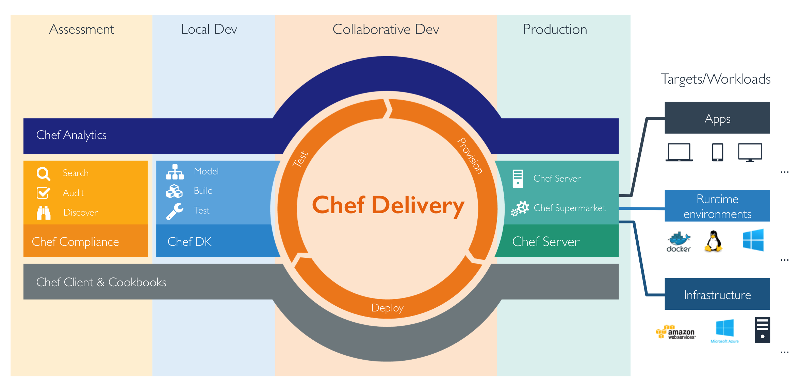

Slide 98

Notes:
I am going to have to pull in some slides from Steve’s Compliance class to talk about Chef Compliance.

Slide 99
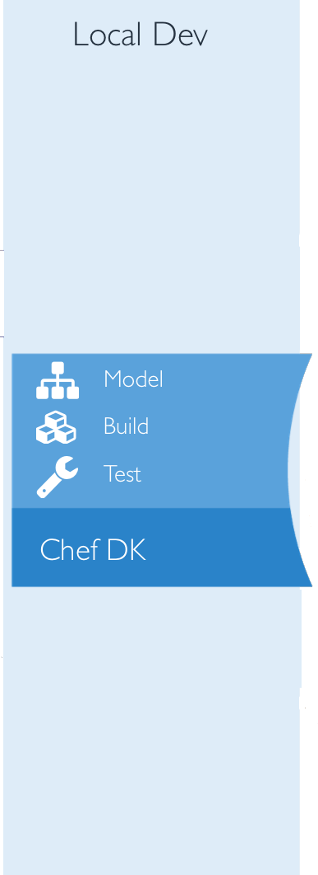

Slide 100
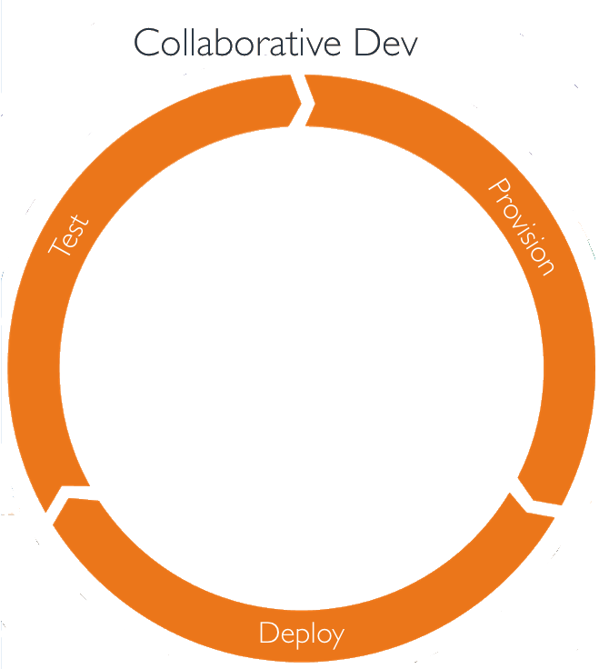

Slide 101
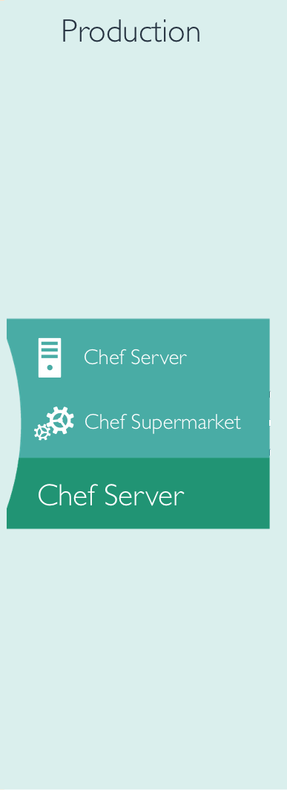

Slide 102

Notes:
Will need some slides from Steve’s class on Chef Analytics???

Slide 103
NODES
Notes:
note docker, linux, windows.
AWS, MS Azure, Bare Metal

Slide 104
?
?
?
?
?
BLDR
?
?
?
?
?
Notes:
this is not official bldr branding by any stretch. Bldr is not ready for primetime – so I do not have access to the branding.

Slide 105
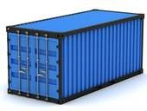


Containers – enables you to move apps from one place to another without breaking anything.
I need to get better information regarding Bldr
Virtual Machine – can be used for pretty much anything, but eats up a lot of resources.
Notes:
Containers are the box and Bldr is the packing peanuts.
I need to write better information explaining Containers/Virtual Machine/Bldr
Also – add info regarding Ansible, AWS, Azure

Slide 107
Use Case for Chef

Slide 108
I AM GOING TO INCLUDE TWO USE CASES – SINGLE NODE AND MULTIPLE NODE AND EXPLAIN WHAT THIS MEANS.
THIS WILL GO TOWARD THE BEGINNING OF THE CLASS – BEFORE WE JUMP INTO CHEF SPEAK, I THINK.

